Slide 1

Session 6 (of 24)
PGR112 Objektorientert programmering
Yuan Lin / yuan.lin@kristiania.no

Slide 2
Today’s Main Goal
Exception Handling
Read from File
Write to File
Logger
Practice Time

Slide 3
Status
Step 1: IntelliJ, Git, Hello World
Step 2: Variable, Method, Data type, Scope, Control statement
Step 3: Class, Object, Scanner, Encapsulation
Step 4: Package, Import, Modifiers, Overload, ArrayList, Enums
Step 5: Scanner (cont.), Input validation, Debugger, Write test
Now: Exception handling, File handler, Logger
…
Notes:
Question here: how do we realize read-only or write-only?
IntelliJ example

Slide 4
What is Exception?
What is Exception in Java?
In Running programs, situations may arise where something abnormal is happening.
“Abnormal” means that the code does not run as it is intended to.
Java definition: An exception is an event, which occurs during the execution of a program, that disrupts the normal flow of the program’s instructions. It is an object which is thrown at runtime.
An exception can occur for various reasons
A user has entered an invalid data
File not found
A network connection has been lost in the middle of communications
The JVM has run out of memory
Notes:
In Java, an exception is an event that disrupts the normal flow of the program. It is an object which is thrown at runtime.

Slide 5
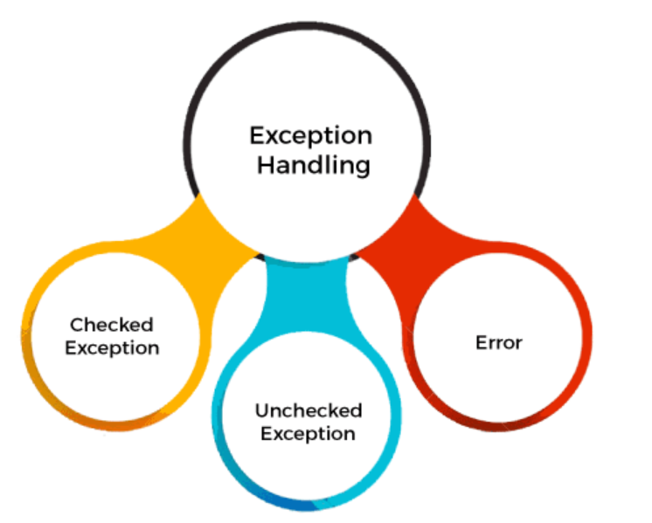
Examples of Exception
Type of Java Exceptions
According to Oracle, there are three types of exceptions namely
Checked Exception
Unchecked Exception
Error
Error is considered as unchecked exceptions
Error vs Exception
Error indicates a serious problem that application should not try to catch
Exception indicates conditions that application might try to catch.
Src: javatpoint
Notes:
In Java, an exception is an event that disrupts the normal flow of the program. It is an object which is thrown at runtime.

Slide 6
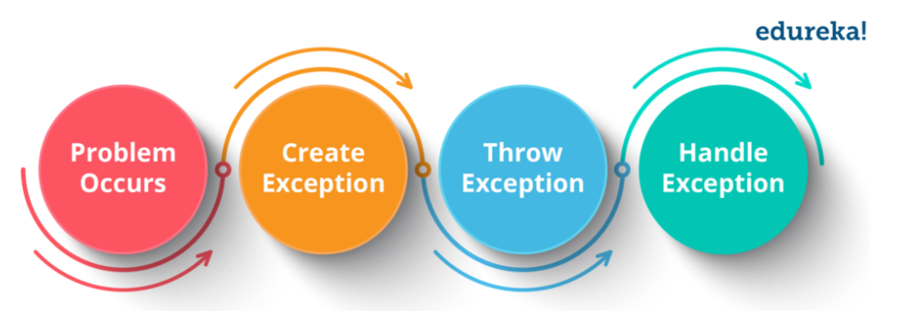
When an Exception Occurs
When an exception occurs
Error occurs inside a method
Creates Exception: an object, contains information about the error, including the type and condition of the program, is created
Throw exception: the exception object is delivered to the runtime system
Handle exception: The runtime system tries to find something to handle the exception
The “something” is the ordered list of methods that had been called to get to the method where the error occured.
The list of methods is called “Call Stack”
Src: https://medium.com/edureka/java-exception-handling-7bd07435508c
Notes:
In Java, an exception is an event that disrupts the normal flow of the program. It is an object which is thrown at runtime.

Slide 7
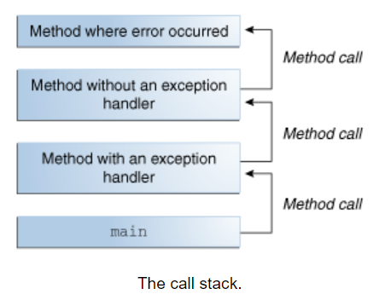
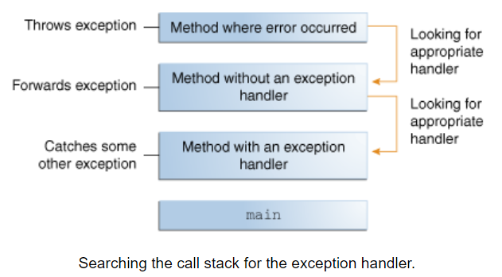
Call Stack
Src: https://docs.oracle.com/javase/tutorial/essential/exceptions/definition.html
Notes:
he search begins with the method in which the error occurred and proceeds through the call stack in the reverse order in which the methods were called. When an appropriate handler is found, the runtime system passes the exception to the handler.

Slide 8
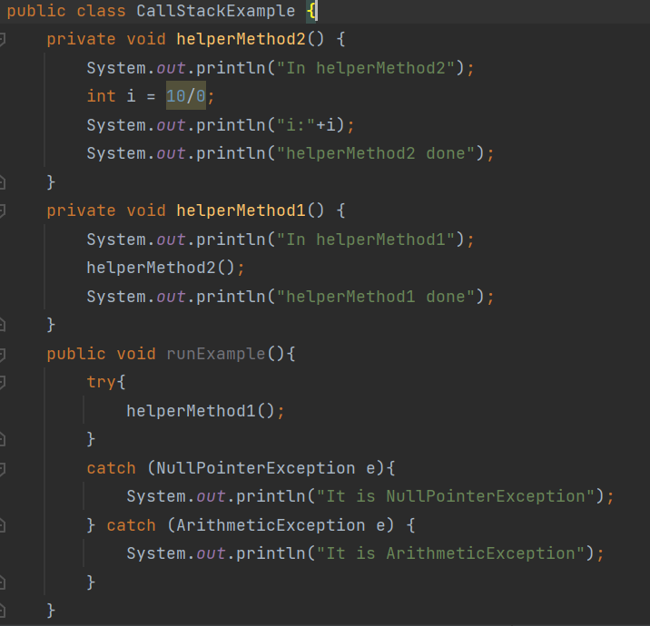
What is Exception Handling?
Exception handling is a mechanism to handle runtime errors.
The core advantage of exception handling is to maintain the normal flow of the application.
If the runtime system exhaustively searches all the methods on the call stack without finding an appropriate exception handler, the runtime system terminates.
Notes:
he search begins with the method in which the error occurred and proceeds through the call stack in the reverse order in which the methods were called. When an appropriate handler is found, the runtime system passes the exception to the handler.

Slide 9
Demo call stack and exception

Slide 10
Three main groups of exceptions
There are three main groups of exceptions
Unchecked exceptions. Bugs or logical errors. Programmer’s error
Checked exceptions. Exceptions checked at compile time
Errors (The application should not try to catch. i.e., hardware failure)
Unchecked exceptions are not necessarily to be handled sicne compiler does not check
Checked exceptions must be handled <catch or specify>
try-catch clause, or
Throws the excepton further – how? Using throws method signature

Slide 11
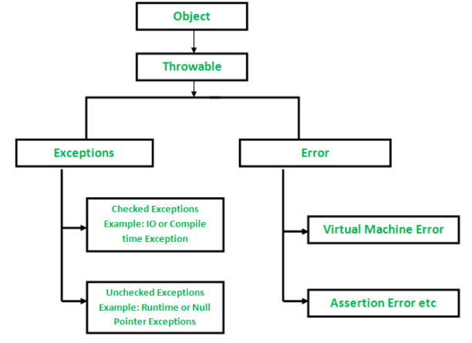
Example of Checked vs Unchecked Exceptions
Checked exception (relevant to this week especially)
FileNotFoundException
IOException
Unchecked exception
ArithmeticException
NullPointerException
ArrayIndexOutOfBoundsException
NumberFOrmatException
Src: https://www.geeksforgeeks.org/checked-vs-unchecked-exceptions-in-java/

Slide 12
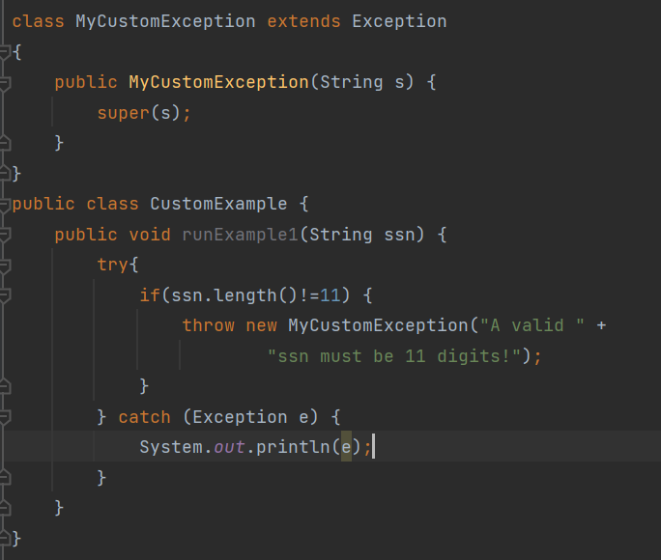
Custom Exception
In Java, we can create our own exceptions.
It needs to be derived from the Exception class.
In which scenarios we want to create custom exceptions?
To catch and provide specific treatment to a subset of existin Java exceptions
When we define our own business logic

Slide 13
Catch or Specify
The main difference between checked and unchecked exceptions is that we MUST take checked exceptions into account
Because the compiler will check
So how do we handle a checked exception?
Try/catch clause
Throw the exception further using throws (it is called method signature)

Slide 14
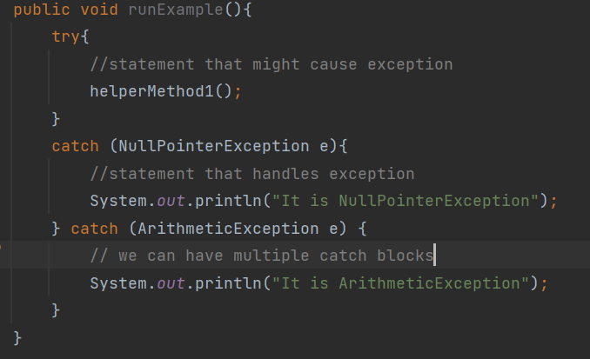
Try-catch clause
Try specifies a block where we should place an exception code
Catch specifies a block where exception handling locates in.

Slide 15
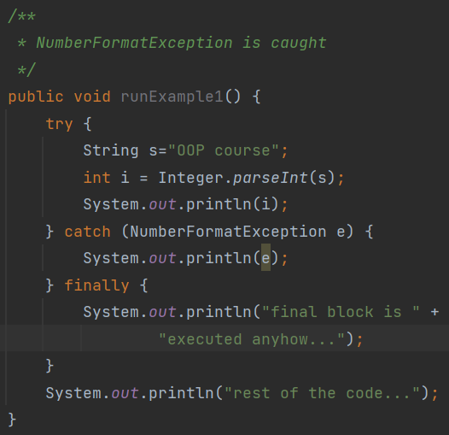
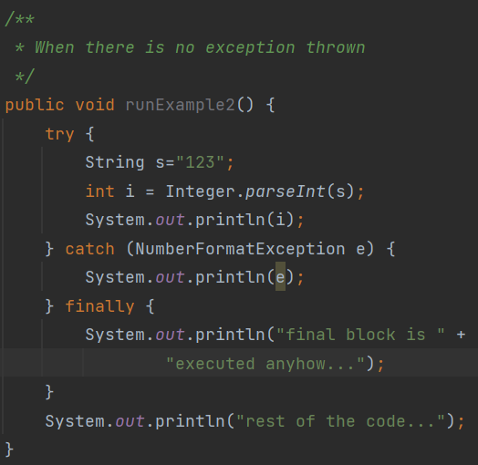
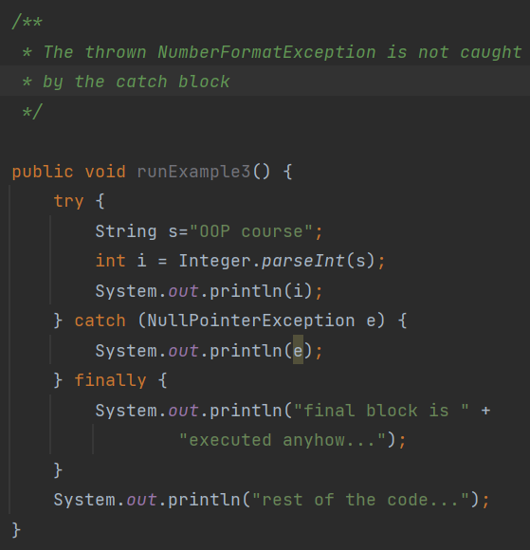
Finally
In addition to try/catch, we can have a finally block that runs after catch.
Finally block will be executed in any circumstances as shown below
We usually put cleaningup code in finally block

Slide 16
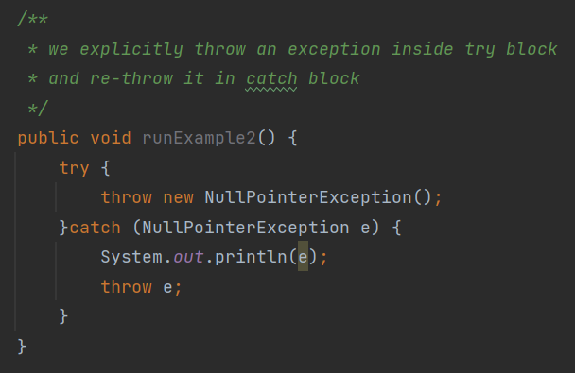
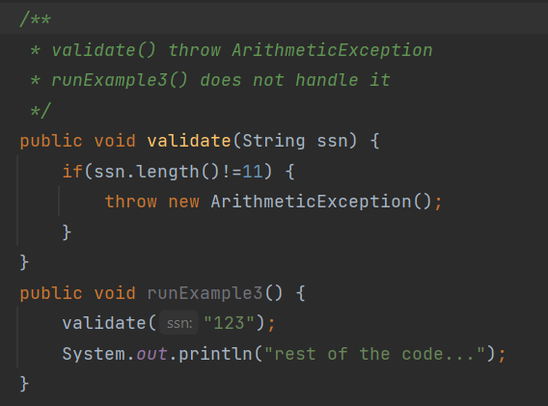
Throw
The throw keyword is used to throw an exception explicitly within a method
We can throw either checked or unchecked exceptions
We can re-throw an exception from catch block
Throw keyword is mainly for throwing a custom exception
Syntax: The throw keyword is followed by an instance of Exception to be thrown

Slide 17
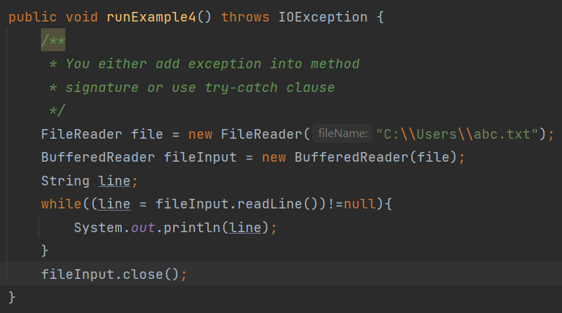
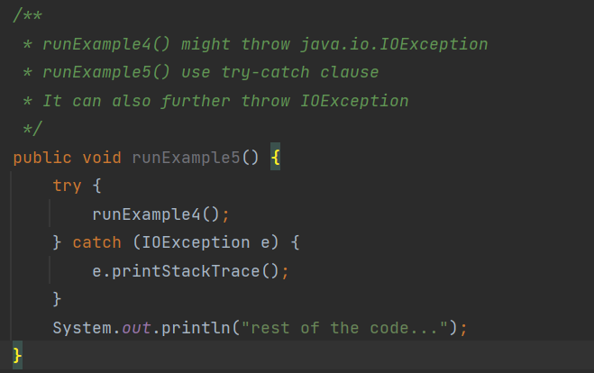
Throws
Throws keyword is used in signature of a method to declare an exception which might be thrown by the function
We can decalre multiple exceptions to be thrown by a function
Syntax: The throws keyword is followed by class name of Exception to be thrown
The throws keyword is used for checked exceptions

Slide 18
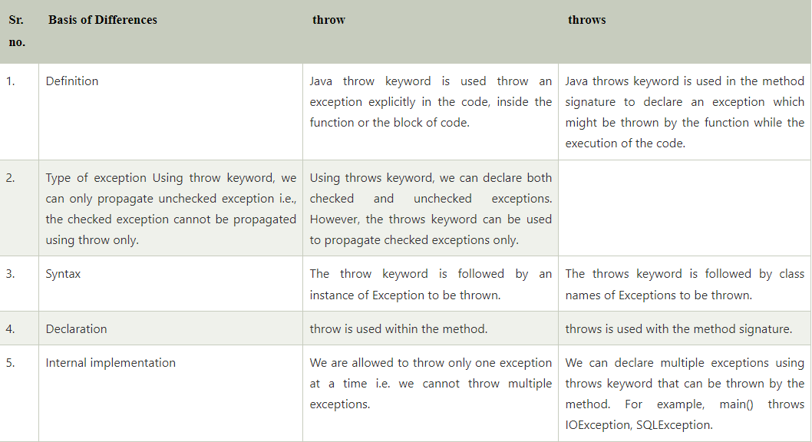
Throw vs Throws
Src:https://www.javatpoint.com/difference-between-throw-and-throws-in-java

Slide 19
Exceptions - Summary
When we call methods that throw checked exceptions, we must decide whether we want to throw the exception further, or process it
Try/Catch/Finally clause to process it
Declare throws in signature of a method to throw it further
Exception handling is a large topic, and we will return to it later. For example:
Custom exceptions
Multi-catch
Try-with-resources
Chained exceptions

Slide 20
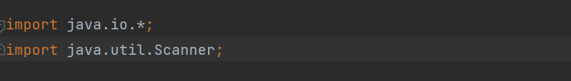
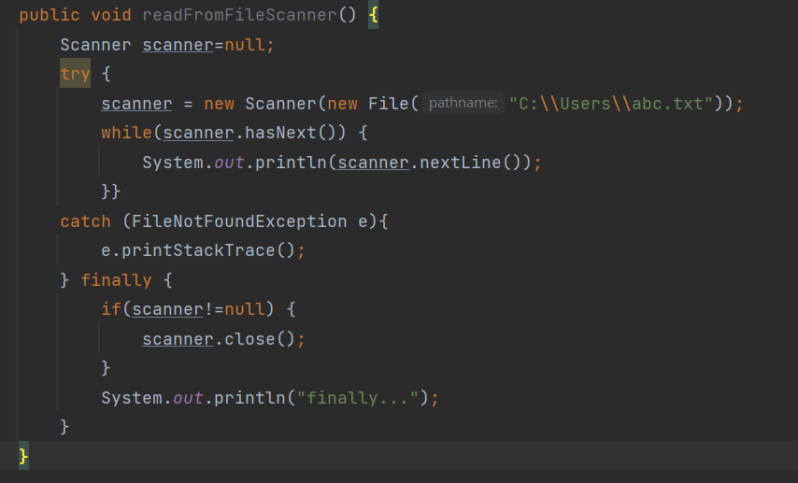
Read from File
We already know Scanner!
You can create a Scanner from System.in
Here we learn how to create a Scanner from file.
Try/catch/finally clause is used for exception handling
FIleNotFoundException is checked exception

Slide 21
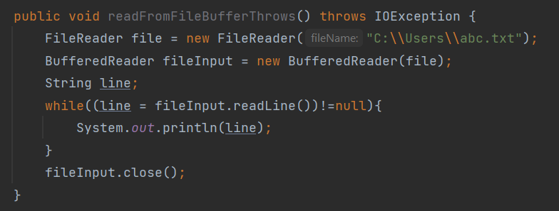
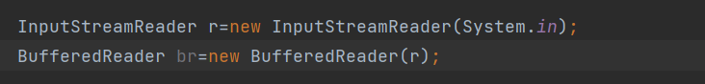
Read from File
We can use FileReader to read from file
FileReader is used to read data from a file.
BufferedReader class is used to read the text from a character-based input stream.
BufferedReader class can also be used to read from System.in

Slide 22
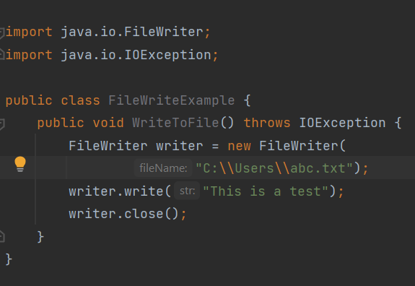
Write to File
FileWriter is used to write data to a file
Note that IOException is further throwed

Slide 23
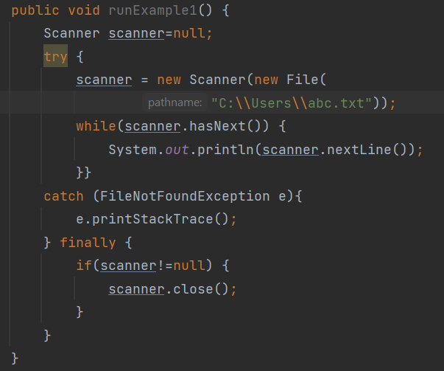
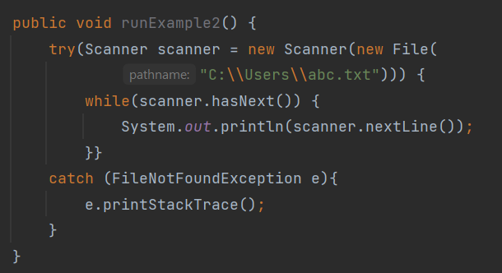
Try-with-resources
Replacing try-catch-finally with try-with-resources
We can declare one or more resources
With try-catch-finally clause, you use finally block to ensure that a resource is closed
With try-with-resources, resource is closed automatically

Slide 24
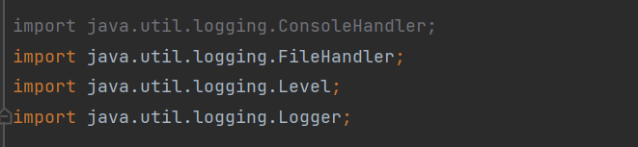
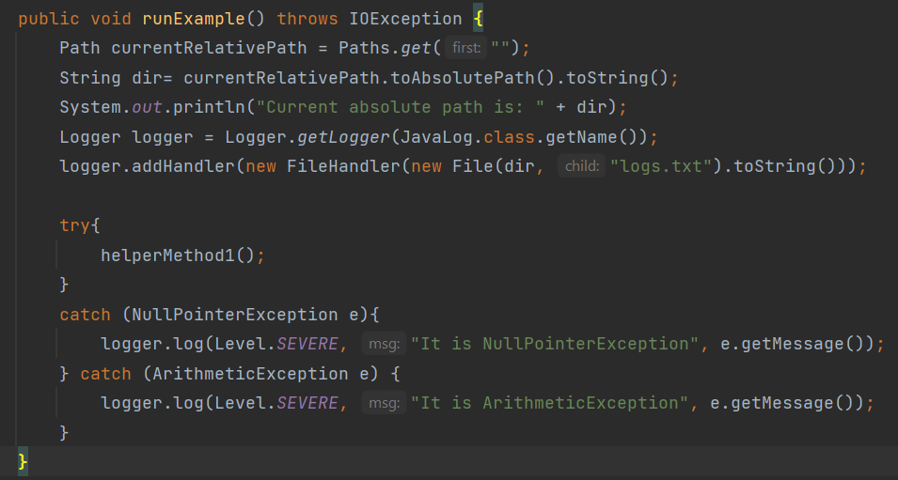
Java Logger
The need for Log capture
Recording unusual circumstances or errors
Getting the infor about what is going in the application
Log level
SEVERE(highest value)
WARNING
INFO
CONFIG
FINE
FINER
FINEST (lowest value)
Java provides Logger class in package java.util.logging.Level
Apache Log4j is popular API which we will introduce later together with Maven

Slide 25
A bit about date and time
Java struggled for a long time to sort out data that had to deal with time and place.
The java.time package contains a lot of goodies you can use
In this week’s assignments, the LocalDate class in particupar is relevant. It represents a date

Slide 26
Create a LocalDate object from textual representation
Java struggled for a long time to sort out data that had to deal with time and place.
The java.time package contains a lot of goodies you can use
In this week’s assignments, the LocalDate class in particupar is relevant. It represents a date
Java LocalDate class is an immutable class that represents Date with a default format of yyyy-mm-dd

Slide 27
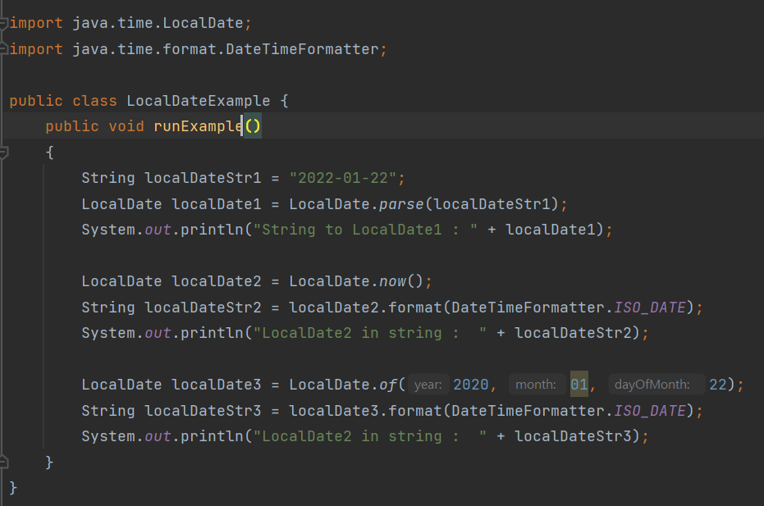
Create a LocalDate object from textual representation

Slide 28
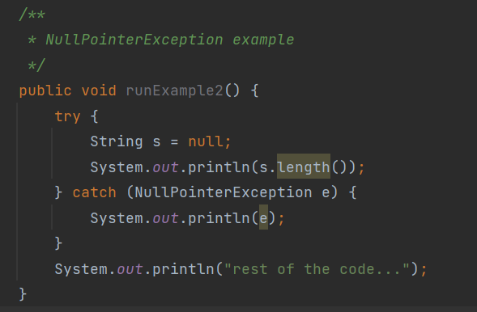
Null
You probably (should?) remember the null from DB topic
We have the same phenomenon in Java (and JavaScript)
NullPointerException is a very common exception to encounter
Occurs when you perform something with an object, for example calls a method defined in the objectm but the object is null

Slide 29
Before we end
Goals for this session:
I understand Java Exceptions
I know how to use Exception Handling
I know how to read from and write to file
I know how to log using Java logging class
I know LocalDate class
I know Null
Remember, do not just read code, play with it. Good luck with the tasks! Remember, there is help available all week, use Mattermost or GitHub.

